Slide 1
REINFORCEMENT LEARNING IN GAMES - VASUKI
BY ASWIN

Slide 2
OBJECTIVE OF PROBLEM
Create a Snake Bot using Reinforcement Learning for the custom environment provided
The Bot should be able to eat as many mice as possible in a game
The objective of the game is to possess a greater score than the opponent either by consuming the food or by colliding with the opponent

Slide 3
PROPOSED SOLUTION
To Build a Reinforcement Q-Learning Agent to select a best action based on the state of the environment
The Agent trained over 1,00,000 episodes with game length of 1000
The Populated Q-Table will result a best action based on the observation of the environment and the opposing agent

Slide 4

Q-Learning
Q-learning is a model-free reinforcement learning algorithm to learn the value of an action in a particular state.
It does not require a model of the environment, and it can handle problems with stochastic transitions and rewards without requiring adaptations.
Q learning is a value-based off-policy temporal difference(TD) reinforcement learning.

Slide 5
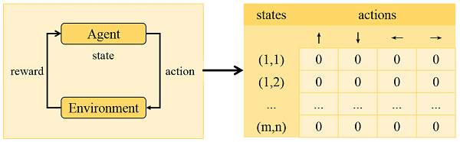
ARCHITECTURE

Slide 6
Input States
The following are the input states of the agent
((foodX, foodY), (enemyX, enemyY), head) = [0 ,1, 2]
foodX, foodY are the relative distance between the agent and the nearest food
enemyX, enemyY are the relative distance between the agent and the enemy
head is the head (or) direction of the agent

Slide 7
METHODOLOGY
The environment is processed using separate function to get the current state of the observation
In the initial training stages, the agent takes random actions for exploratory and update the Q-table
In later stages, the epsilon value will be decayed and the agent will take best probable action from the Q-table based on the current state
The values in the Q-table are updated using the formula from Q-Learning

Slide 8
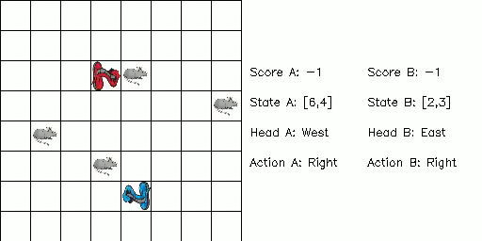
Demo

Slide 9
Thank You

